Slide 1
Burrows Wheeler Transform
The Burrows Wheeler Transform (BWT) is a data transformation algorithm Invented by Michael Burrows and David Wheeler in 1994.
BWT restructures data in such a way that the transformed message is more compressible.
Technically, BWT deals with lexicographical reversible permutation of the characters of a string.
BWT rearranges a character string into runs of similar characters. So the main concept of BWT implementation on a string is to convert the repeats to runs!
BWT is useful for compression, since it tends to be easy to compress a string that has runs of repeated characters . More importantly, the transformation is reversible!
The idea of the BWT is to build a 2D array whose rows are all cyclic shifts of the input string in dictionary order and return the last column of the array that tends to have long runs of identical characters.
The benefit of this is that once the characters have been clustered together, they effectively have an ordering, which can make our string more compressible for other algorithms like run-length encoding, move-to-front transform (MTF), Huffman Coding, etc.
BWT is used in data preparation for use with the data compression technique bzip2.

Slide 2
Burrows Wheeler Transform
Most important application of BWT is found in biological sciences where genomes (long strings written in A, C, T, G alphabets) don’t have many runs but they do have many repeats.
Genomes look like this: (long string of A, T, C and G)
……….ATCGCATGGATCCGATGCAATGCCGGTA……….
It can be seen that, the characters A, T, C and G gets repeated in the structure of Genome. If you want to store this genome, it would take enormous space! So the basic idea is to convert the repeats to runs and if we can do that, then it can be compressed to such a form that will definitely take less amount of space than the original genome sequence in terms of storage. For example, if we can convert the above sequence in the following:
………TTTTTCCCCAAAAATTTTTTGGGGGCCCCC………
Then it can easily compressible to …..5T4C5A6T5G5C…..
And this will definitely take less amount of space in terms of storage

Slide 3
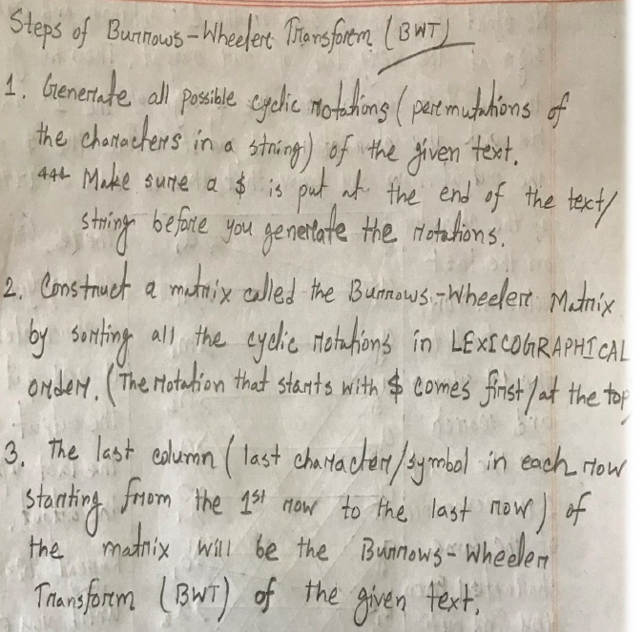
Steps of Burrows Wheeler Transform
After adding the $ to the end of the string of length n, the updated will be n + 1
Dimension of
the 2D BW Matrix for a given string of length n will be:
BWM [n+1][n+1]
BWT of the given text will be the characters residing at the last column of the 2D BW Matrix

Slide 4
Cyclic Rotation and Total No. of Permutations
Cyclic rotation or Circular Shift of the characters of a string/text is the operation of rearranging the characters, either by moving the final character (rightmost character) to the first position, while shifting all other characters to the next position, or by performing the inverse operation. This is very much alike to Bitwise Rotation in Computer Programming!
In BWT, we have to repeatedly apply circular shifting/circular rotation to the given sequence of characters and we stop just before getting the original sequence back!
For example, in terms of BWT implementation, repeatedly applying circular shifts/circular rotation of the string a b c d $ successively gives us the following:
a b c d $ -> $ a b c d -> d $ a b c -> c d $ a b -> b c d $ a
Circular shift/Circular rotation is a special kind of cyclic permutation, which in turn is a special kind of permutation!
So, total no. of string permutations that will be generated after successively applying circular rotation to the given string of length n is n+1 as we have to add a $ sign at the rightmost position of the text starting to apply cyclic rotation!

Slide 5
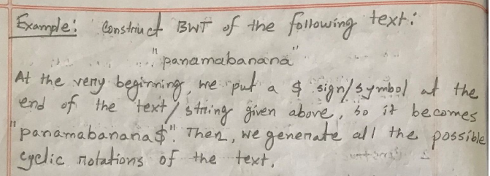
Example#1 of Burrows Wheeler Transform
What is the BWT of “panamabanana”?

Slide 6
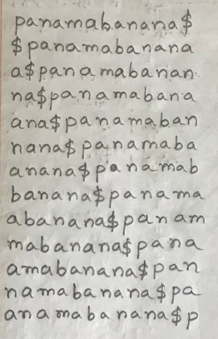
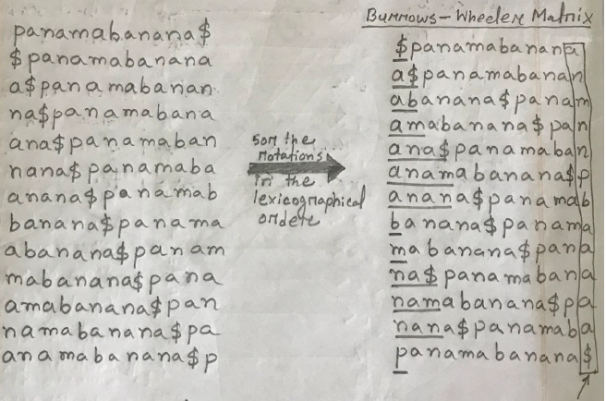
Example#1 of Burrows Wheeler Transform

Slide 7
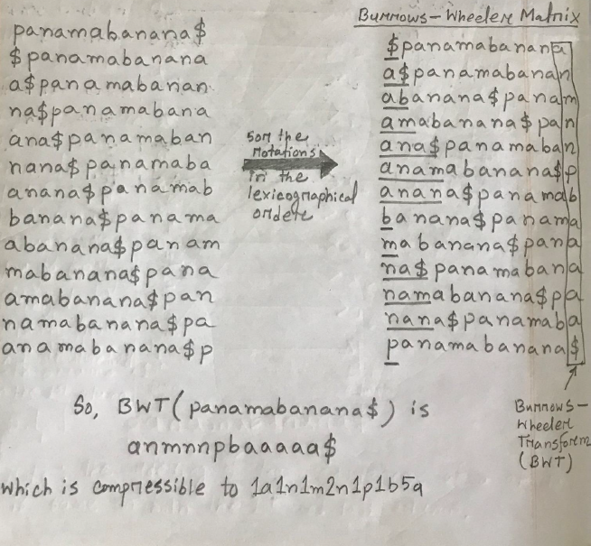
Example#1 of Burrows Wheeler Transform

Slide 8
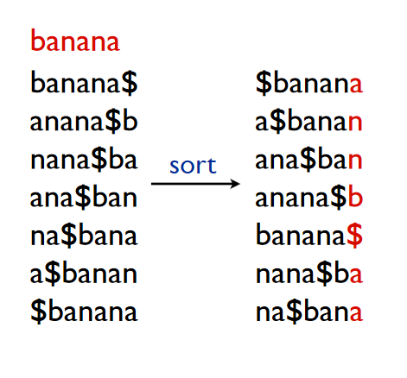
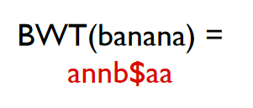


Example#2 of Burrows Wheeler Transform
What is the BWT
of “banana”?

Slide 9
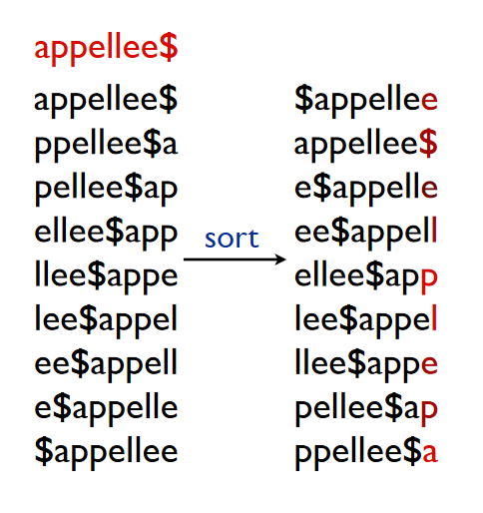
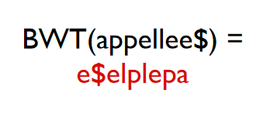
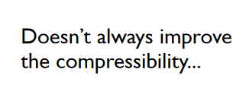
Example#3 of Burrows Wheeler Transform
What is the BWT
of “appellee”?

Slide 10
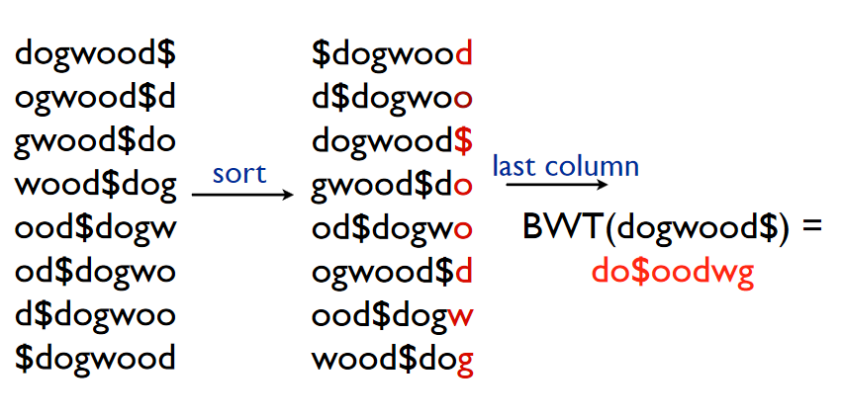
Example#4 of Burrows Wheeler Transform
What is the BWT of “dogwood”?

Slide 11
Necessary Links
https://www.cs.cmu.edu/~ckingsf/bioinfo-lectures/bwt.pdf
https://www.geeksforgeeks.org/burrows-wheeler-data-transform-algorithm/
https://en.wikipedia.org/wiki/Burrows%E2%80%93Wheeler_transform

